Slide 1



s
e
c
o
n
d
C
O
R
N
A
N
I
T
H
I
S
1.1-11
A free CD of this message will be available following the service
It will also be available for podcast later this week at calvaryokc.com

Slide 2
Plato – “Corinthian girl” (prostitute)
Temple of Aphrodite: 1000 temple prostitutes
Aristotle – korinthiazomai (fornication)
O
A
N
S
1.1-11
I
I
s
e
c
o
n
d
C
R
N
T
H

Slide 3
O
A
N
S
1.1-11
I
I
s
e
c
o
n
d
C
R
N
T
H

Slide 4



Arrives in Corinth and begins church (Acts 18.1)
Writes 1st letter from Ephesus (now lost) (1 Cor. 5.9)
Writes "sorrowful" letter (now lost) from Ephesus (2 Cor. 2.1)
Writes 1 Corinthians
AD 51
AD 52
AD 53
AD 54
AD 55
AD 56
Leaves Corinth for Ephesus (Acts 18.18)
1st letter being misunderstood, church sends delegation to Paul w/ specific questions (1 Cor. 16.17)
Makes “hasty” visit (2 Cor. 2.1)
Writes 2 Corinthians
O
A
N
S
1.1-11
I
I
s
e
c
o
n
d
C
R
N
T
H

Slide 5
O
A
N
S
1.1-11
I
I
s
e
c
o
n
d
C
R
N
T
H

Slide 6
Blessed – noun form of eulogeō – speak well of (eulogy)
Father of mercies – I. e. the Originator of mercies
O
A
N
S
1.1-11
I
I
s
e
c
o
n
d
C
R
N
T
H

Slide 7
O
A
N
S
1.1-11
I
I
s
e
c
o
n
d
C
R
N
T
H

Slide 8
comfort – either paraklēsis (n.) or parakaleō (v.) – 29x in 2 Corinthians
10x in vv. 3-7
comfort, plead, desire, pray exhort, called, entreat, beseech admonish, instruct
that which always seeks the best
comfort – with strength
O
A
N
S
1.1-11
I
I
s
e
c
o
n
d
C
R
N
T
H

Slide 9
Tribulation – thlipsis – (Medical term) “compression or constriction by an outside cause, esp of the blood vessels or another part of the body.”
O
A
N
S
1.1-11
I
I
s
e
c
o
n
d
C
R
N
T
H

Slide 10
John 14.16-18 – ¹⁶ And I will pray the Father, and He will give you another Helper , that He may abide with you forever—¹⁷ the Spirit of truth, whom the world cannot receive, because it neither sees Him nor knows Him; but you know Him, for He dwells with you and will be in you. ¹⁸ I will not leave you orphans; I will come to you.
O
A
N
S
1.1-11
I
I
s
e
c
o
n
d
C
R
N
T
H

Slide 11
John 14.26 – But the Helper, the Holy Spirit, whom the Father will send in My name, He will teach you all things, and bring to your remembrance all things that I said to you.
O
A
N
S
1.1-11
I
I
s
e
c
o
n
d
C
R
N
T
H

Slide 12
John 16.7 – Nevertheless I tell you the truth. It is to your advantage that I go away; for if I do not go away, the Helper will not come to you; but if I depart, I will send Him to you.
O
A
N
S
1.1-11
I
I
s
e
c
o
n
d
C
R
N
T
H

Slide 13
O
A
N
S
1.1-11
I
I
s
e
c
o
n
d
C
R
N
T
H

Slide 14
C.S. Lewis – “If you look for truth, you may find comfort in the end; if you look for comfort you will not get either comfort or truth only soft soap and wishful thinking to begin, and in the end, despair.”
O
A
N
S
1.1-11
I
I
s
e
c
o
n
d
C
R
N
T
H

Slide 15
O
A
N
S
1.1-11
I
I
s
e
c
o
n
d
C
R
N
T
H

Slide 16
Jacob – supplanter, “heel-catcher”
Israel – “ruled by God”
O
A
N
S
1.1-11
I
I
s
e
c
o
n
d
C
R
N
T
H

Slide 17
O
A
N
S
1.1-11
I
I
s
e
c
o
n
d
C
R
N
T
H

Slide 18
Phillips – At that time we were completely overwhelmed, the burden was more than we could bear, in fact we told ourselves that this was the end. Yet we believe now that we had this experience of coming to the end of our tether that we might learn to trust, not in ourselves, but in God who can raise the dead.
O
A
N
S
1.1-11
I
I
s
e
c
o
n
d
C
R
N
T
H

Slide 19
Message – We felt like we’d been sent to death row, that it was all over for us. As it turned out, it was the best thing that could have happened. Instead of trusting in our own strength or wits to get out of it, we were forced to trust God totally—not a bad idea since he’s the God who raises the dead!
O
A
N
S
1.1-11
I
I
s
e
c
o
n
d
C
R
N
T
H

Slide 20
Rom. 5.3b-4 – 3b knowing that tribulation produces perseverance; ⁴ and perseverance, character; and character, hope.
O
A
N
S
1.1-11
I
I
s
e
c
o
n
d
C
R
N
T
H

Slide 21
O
A
N
S
1.1-11
I
I
s
e
c
o
n
d
C
R
N
T
H

Slide 22

1 Cor. 1:18 ~ For the message of the cross is foolishness to those who are perishing, but to us who are being saved it is the power of God.
past
Future
PRESENT
Eph. 2:8 – For by grace you have been saved through faith, and that not of yourselves; it is the gift of God,
Rom. 8:17 ~ and if children, then heirs—heirs of God and joint heirs with Christ, if indeed we suffer with Him, that we may also be glorified together.
O
A
N
S
1.1-11
I
I
s
e
c
o
n
d
C
R
N
T
H

Slide 23
O
A
N
S
1.1-11
I
I
s
e
c
o
n
d
C
R
N
T
H

Slide 24
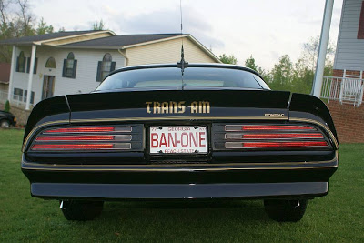
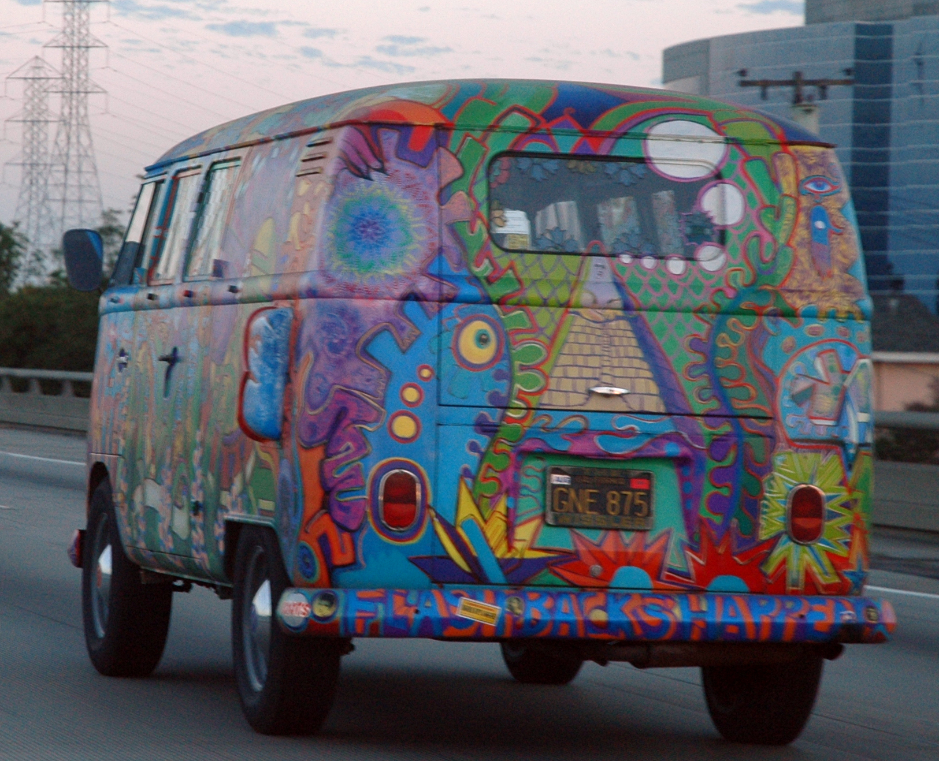
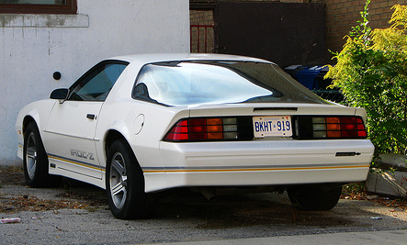
Prayer Doesn’t Change Things
It Changes People
People Change Things
PrayerChangesThings
Prayer Doesn’t Change
Things … It Changes People
PrayerChangesThings
60s
Prayer Doesn’t Change Things
It Changes People
People Change Things
70s
Prayer Doesn’t Change
Things … It Changes People
80s
O
A
N
S
1.1-11
I
I
s
e
c
o
n
d
C
R
N
T
H

Slide 25
O
A
N
S
1.1-11
I
I
s
e
c
o
n
d
C
R
N
T
H

Slide 26
R. V. G. Tasker – “There is not limit to the power of intercessory prayer; and though the display of God's mercy does not depend upon it, we may be sure that He desires nothing more than that His people should be united in mutual intercession offered in the name of His Son.
O
A
N
S
1.1-11
I
I
s
e
c
o
n
d
C
R
N
T
H

Slide 27
R. V. G. Tasker – When such prayer in answered, it results in an outburst of praise and thanksgiving which redounds greatly to God's glory.”
helping together – sunupourgeō
sun – with
hupo – under
ergon – work
O
A
N
S
1.1-11
I
I
s
e
c
o
n
d
C
R
N
T
H

Slide 28
O
A
N
S
1.1-11
I
I
s
e
c
o
n
d
C
R
N
T
H

